Slide 1

Ada Burch
Ada has 15 years of experience as a principal, information architecture, content design, and conversational design. She has worked in the Financial, medical, and technology industries for Google, Mayo Clinic, EY, Accenture, USAA, and Intuit. She is an advocate for the people whose products she works on and a team player who takes the initiative to quickly adapt the brand tone and voice across all communications.
Conversational Designer
content designer
Creative force for hire

Slide 2
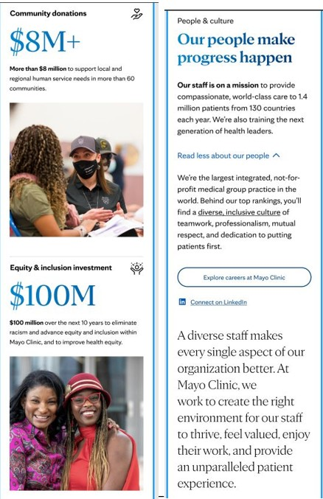
The Story of Mayo Clinic Unfolds
Mayo CLinic
Mayo Clinic, the number one hospital in the U.S., set out to redesign its website to better reflect its values of diversity, accessibility, and patient-centered care—and to meet the needs of millions of patients seeking guidance and connection. With over 2 million monthly views across its top pages, the site needed to inspire trust, guide patients, and reflect the real people it serves.
[INSERT WORK SAMPLE HERE]
The Details
30% increase in patient engagement across redesigned pages
Unified messaging that reflected Mayo’s commitment to care, trust, and excellence
More inclusive, accessible content that resonated with a global audience

Slide 3
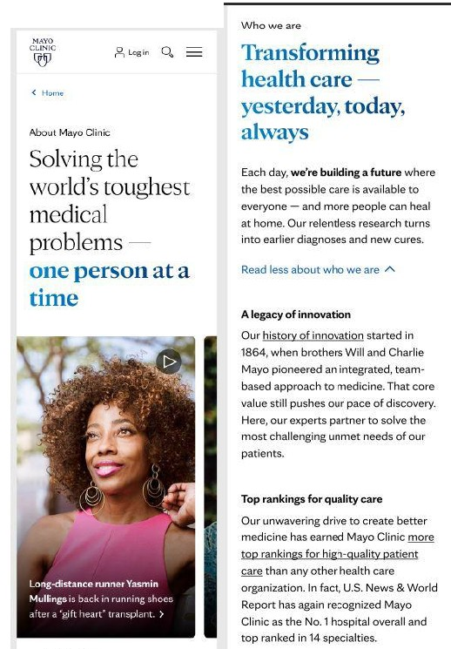
The Story of Mayo Clinic Unfolds
Project Details
Ada Burch
Content Designer
[INSERT WORK SAMPLE HERE]
I partnered with cross-functional teams to reimagine content not just as a strategic experience. I guided voice and tone and built storytelling frameworks. I led content teams into key meetings with leadership, helping shape project goals, define user-centered approaches, and align evaluation criteria to measure success.
The Approach
Made medical information more approachable and relatable
Elevated Mayo’s story through cohesive, values-driven messaging
Prioritized accessibility and inclusivity for a broader, more diverse audience

