Slide 1

Ada Burch
Ada has 15 years of experience as a principal, information architecture, content design, and conversational design. She has worked in the Financial, medical, and technology industries for Google, Mayo Clinic, EY, Accenture, USAA, and Intuit. She is an advocate for the people whose products she works on and a team player who takes the initiative to quickly adapt the brand tone and voice across all communications.
Conversational Designer
content designer
Creative force for hire

Slide 2
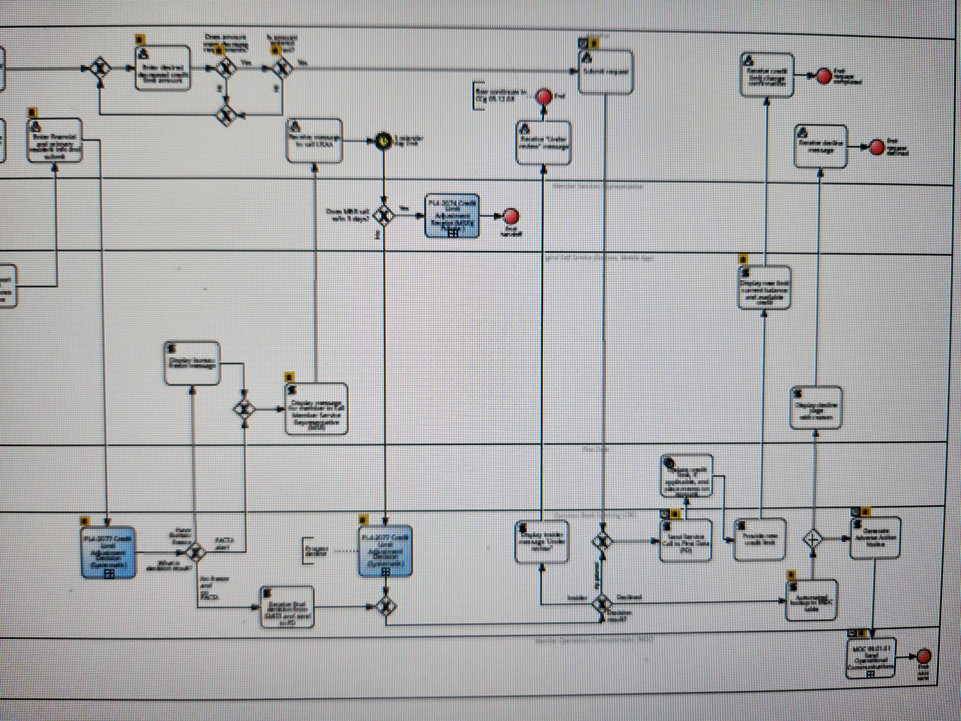
A Bank in Need
Financial Services
A major bank was struggling with low digital engagement and customer frustration stemming from fragmented virtual support. Their chatbot and virtual assistant tools offered limited functionality and frequently misinterpreted customer intents, leading to increased call center volume and poor customer satisfaction scores.
[INSERT WORK SAMPLE HERE]
The Details
Increased overall usability by 18, according to internal usability testing.
Decreased technical debt, reducing complexity and streamlining future maintenance.
Improved chatbot performance and contributed to faster task completion and higher customer satisfaction scores.
Reduced product-related software issues by 15%, helping engineering teams move faster with fewer bugs.

Slide 3
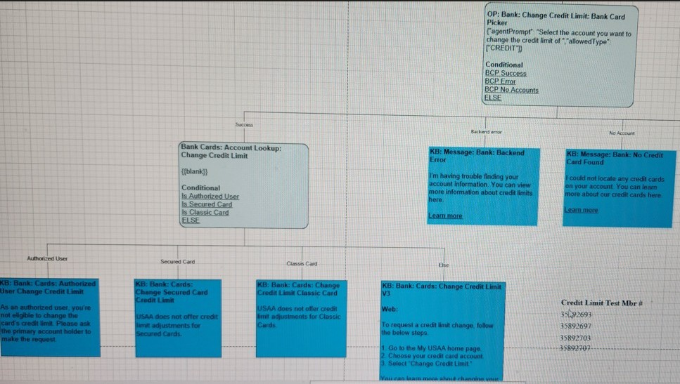
A Bank in Need
Project Details
Ada Burch
Conversational Designer
I Collaborated with cross-functional teams including Product, UX Design, Engineering, and Business to integrate conversational logic into digital tools, resulting in a higher customer satisfaction.
The Approach
Led strategic conversational content initiatives and determined needs, objectives, approaches, and evaluation criteria that expanded customer reach and increased customer engagement by 18%.
Designed end-to-end conversational experiences, including chatbot flows and virtual assistant interactions, across customer-facing platforms that simplified interactions and added value propositions.

Slide 4
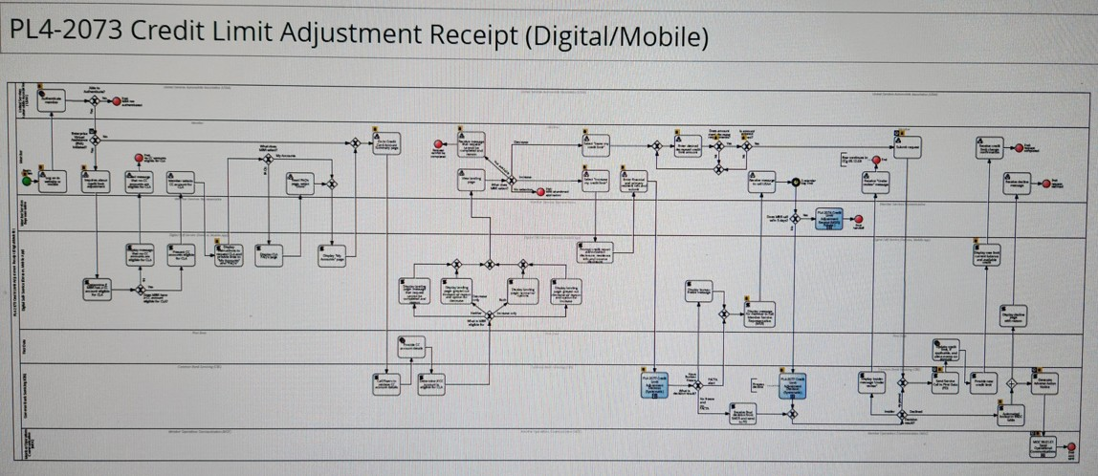
A Bank in Need
Project Details
Ada Burch
Conversational Designer

