Slide 1

XD Expert Review
Transformation by Design
11/21/2019
Robert T Harris – XD Research Lead
Ada Burch– UX Strategist

Slide 2
Contents
  Purpose
  Methodology
  Summary
  Top Findings
  Detailed Findings and Recommendations
  Next Steps
  Detailed Review Criteria
  Appendix

Slide 3
Purpose
  Identify areas of the user interface that may pose problems for users
  Catch “low-hanging fruit” – obvious problems that do not require observational user research data to find, justify and correct
  Support and allows user research testing to uncover deeper issues
  Two evaluators, working independently, can identify the majority of problems in an interface
  An Expert Review is also known as a Heuristic Evaluation

Slide 4
Methodology
  Two experienced user experience practitioners systematically evaluated the Transformation by Design application interface and “wore the user’s hat.”
    Each evaluator performed task-based and screen-by-screen evaluations.
    A worksheet with detailed review criteria was employed to ensure consistency in approach.
  Industry standard principles and best practices were employed covering:
    Ease of Use
    Visual Layout & Design
    Text & Content
  Findings sets were combined, Conclusions and recommendations are made based upon the intersection of findings.

Slide 5
Methodology
  Tasks guiding the evaluation included:
    New User Registration
    Existing User Login
    Find, Add, Update a Client
    Find, Add, Update a User
    Add Client Access to a User
    My Transformations - Projects Dashboard
    Create a New Project
    Update an Existing Project
    Close a Project
    Add Tools to a Project
    Add Activities to a Project

Slide 6
Methodology
  Severity Ratings and Scoring
  During evaluation, each finding was tagged with a severity rating and an overall summary score based upon industry best practices was generated for each heuristic category covered
    Severity Ratings are tagged as follows:
      J = Enhances Usability
      L = Causes difficulty, irritates or annoys
      M = Causes confusion, failure or disrupts tasks
      [ = Detracts visually
    Scores are based on a scale of 0-10 (0 lowest, 10 highest)
      9-10 = Good
      6-8 = Satisfactory with some improvement needed
      0-5 = Requires improvement

Slide 7
Top Findings
  Top-level organization is easily understood and discoverable
  Look and feel is pleasant: clear layout and effective use of color
  Primary calls to action are well placed and easily discovered
  Primary areas for improvement
    Inconsistencies in and ease of use of data tables
    Mixed-state page areas
    Lacking object page for Projects
    Non-extensible use of Wizard flows
    Call to action enabling
    Terminology inconsistencies
    Status display color mismatches
    System messages and error handling display
    Changing look and feel across application areas

Slide 8
Scoring by Evaluation Category
Ease of Use | 5
Visual Layout & Design | 8
Text & Content | 8
Overall Score | 7
Scores on scale of 0-10 (0 lowest, 10 highest)
  9-10 = Good
  6-8 = Satisfactory with some improvement needed
  0-5 = Requires improvement

Slide 9

Detailed Findings & Recommendations

Slide 10
Findings & Recommendations
  Severity Ratings Key
Enhances Usability | J
Causes difficulty, irritates or annoys | L
Causes confusion, failure or disrupts tasks | M
Detracts visually | [

Slide 11
General: Data Tables
M | UI Behavior: Inconsistent table interactions between pages (Users, Clients, Projects, Tools, Activities). Some tables include clickable item labels while others have no clickable items outside the 3-dot menu control. UI Behavior: Table sort settings are not retained within session. Task Support: Columns may not be in the most natural order for intended users, but they are not movable. Task Support: Search has no “clear” function. User must manually delete previously entered search criteria.
R | Recommendations: Consider making all tables consistent with rows clickable (the entire row). This action will perform the data table object’s default or primary action. Two options to consider: 1. Single click or tap performs the primary action associated with the object. 2. Single click/tap highlights the row while double click/tap performs the primary action associated with the object. If objects are currently displayed in a table that have no associated primary action, consider updating the display to not use a table for these areas (i.e. Activities). Consider retaining user selected sort settings per data table within session. Consider allowing for reordering of columns or add/remove columns. Consider adding an [X] clear function to all Search bar areas to clear text entry via single click.

Slide 12
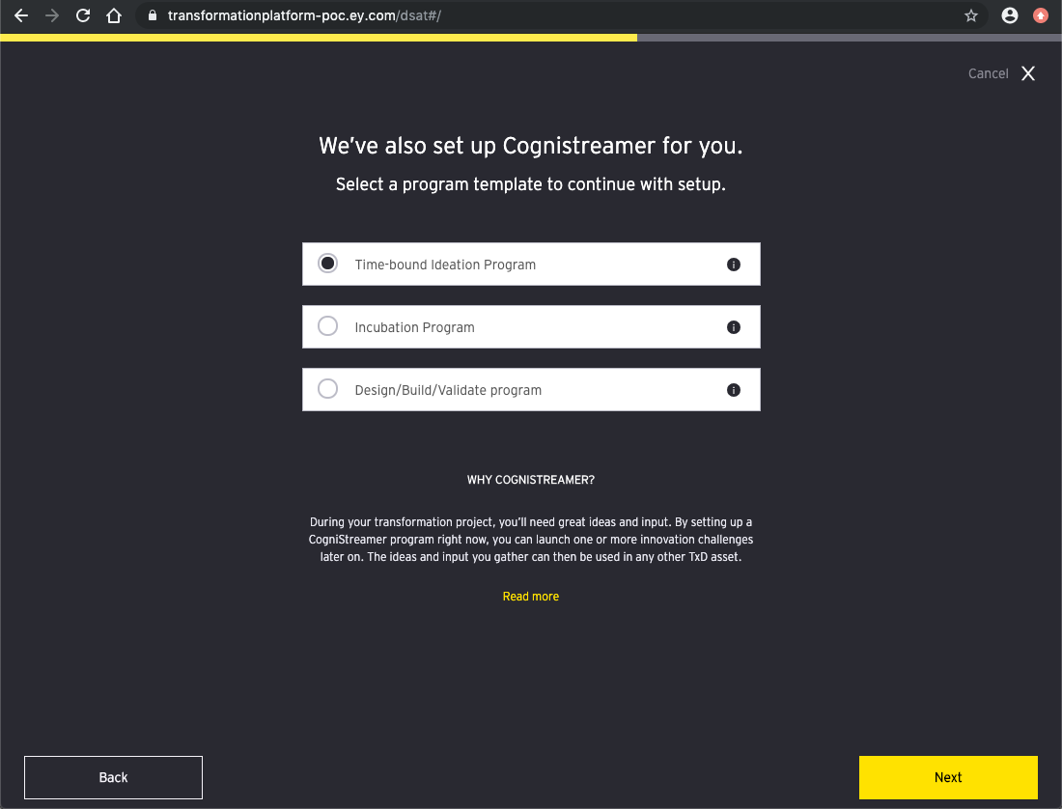
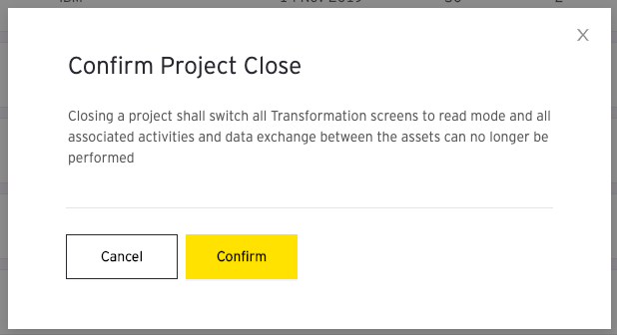
General: Calls to Action
L | Terminology: CTAs that perform the same function have different labels (Update vs. Save).
M | Task Support: Keyboard mapping is not present for primary CTAs across the application. UI Behavior: Inconsistent enabling of CTAs based upon user input or update. Some are enabled by default when no data entry has been performed.
R | Recommendations: Update CTAs to employ consistent labeling where the function is the same. In all areas where a primary call to action appears (i.e. Save, Next, etc.), the primary CTA should always be mapped to the keyboard Enter/Return key. Ensure all CTA enabling is based upon required data entry or data update.

Slide 13
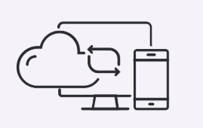
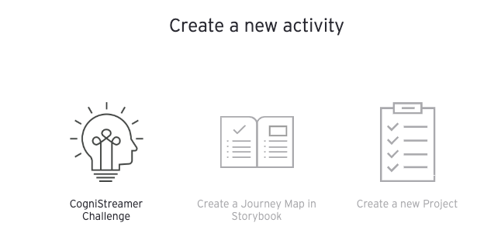


General: Imagery and Iconography
M | Presentation: Iconography is inconsistent in function, does not convey clear meaning and is not accompanied by text. UI Behavior: The “Launch” icon results in a different interaction depending upon context - Launch Activity vs. Launch Tool. The same is true of “Edit” – Edit Client or User vs. Edit Project.
[ | Presentation: Some Tool related imagery appears only in the Create Activity area of the application but is not extended beyond.
R | Recommendations: Consider that "Universal" icons are rare. Icons tend to be ambiguous and should be presented with a text label when possible (without any interaction from the user). Hover should not be the only method to understand an icon’s function as it’s not possible to “hover” in mobile contexts. "Launch" and “Edit” actions should be consistent in function. If actions are different across pages for Launch, consider introducing another icon. Also, the word "Launch" itself may be ambiguous to the user. Consider changing this label to reflect the action directly (i.e. "Access Tool" or "Open Activity") Use of imagery can be powerful, but can also be distracting if not employed consistently or with clear meaning. Consider extending the use of tools imagery or eliminating it as a one-off within the wizard flow.

Slide 14
General: System Message Handling
M | Presentation: System Messages (Error, Success) are displayed atop and cover the UI display, individually, and without a specific page message area or format. UI Behavior: When messages are displayed they are dismissed automatically without user interaction. UI Behavior: Error messages do not contain sufficient data to aid with error recovery. UI Behavior: Success messages do not convey concise meaning.
[ | Presentation: Messaging may result in numerous messages appearing with varying information and/or a combination of error and success.
R | Recommendations: Consider creating a unified message display area where all message types are displayed. This may be a system bug. However, Messages should be "sticky" for any display that contains an Error or Warning. Success messages do not necessarily require user interaction to dismiss. Consider rewriting all error messaging to ensure they aid the user in recovery from the reported error. Consider rewriting all success messaging to ensure they are clear and concise in meaning. Multiple message handling should be considered as part of the overall unified message display design and handle multiple message types gracefully.

Slide 15
Top Level Organization
J | Navigation areas are clearly defined and easily discovered.
L | UI Behavior: Label mismatch. Navigation labels do not match target page header labels.
M | UI Behavior: Lack of application name home link. Presentation: Alignment - center aligned navigation. UI Behavior: EY logo not linked.
R | Recommendations: Consider aligning all navigation labels and related target page headers to be consistent. Consider linking the application name display to the primary landing page of the app. Consider aligning the navigation to the left of the display beside the application name display. Link the EY logo to the primary landing page of the app.

Slide 16
Login & Registration Process
J | Calls to Action are clearly defined.
L | Presentation: Too much welcome text. Text reads like marketing copy.
M | Task Support: No "Register" option. The Current Registration flow also forces an error condition of "Unauthorized Access" after the user selects ”Login" if not already registered. Task Support: Language selection absent from login (and application). UI Behavior: Registration invokes the user's default email client to send a registration email.
[ | Presentation: Background image should be generic. Utilizing an image of the application itself can lead to mismatch between the image and the actual application as it evolves.
R | Recommendations: Welcome text should be limited to "Welcome to <APP NAME>." Consider update of welcome text or move copy to an information icon w/ flyout display if required. Consider adding: "New User? Request Access" link text, where “Request Access” is a hyperlink, and avoid the “Unauthorized” error condition as a step in registration. As a global application, multi-language support should be included and selectable on the login page and within the application. Consider automation of the registration process via a form within the application. Consider a generic background image of either technology or nature which changes via random selection upon session initiation to remain fresh.
R | Recommendations: Welcome text should be limited to "Welcome to <APP NAME>." Consider update of welcome text or move copy to an information icon w/ flyout display if required/wanted. Consider adding: "New User? Request Access" link text, where “Request Access” is a hyperlink, and avoid the “Unauthorized” error condition as a step in registration. As a global application, multi-language support should be included and selectable on the login page and within the application. Consider automation of the registration process via a form within the application. Consider a generic background image of either technology or nature which changes via random selection upon session initiation to remain fresh.

Slide 17
My Transformations Page
J | Add capability is clearly defined.
L | UI Behavior: Labeling mismatch between navigation selection and target page header. Presentation: Disassociation between Stats & Trends label and related metrics display.
M | UI Behavior: Two differing status types appear in the table. One for Project: Active/Closed and one for Tools: Pending/Failed. UI Behavior: Activity Status - Hover is the only method for information access. Information displayed is too generic – no recovery. Pending and Failed are both displayed using the same color. Task Support: Number of tools displayed is inconsistent with the number of tools associated to a project. Task Support: Edit does not open full object (as on other pages). Edit here only supports a subset of field update actions.
R | Recommendations: Page header label should match the navigation item selected. Consider more closely grouping the Stats & Trends data or changing layout. Consider changing the Status column label to "Project Status.” Consider rolling up activity errors and adding specific information as to what is in error and why. Require click versus only display information on Hover event. Separate display and color for items that need attention (error) versus those that do not (pending). May be a system bug, but data display should be consistent between the object table and it’s related page information. Consider moving these editable items to the Project page and having the edit function lead there

Slide 18
Confirm Project Close Dialog
J | Calls to action are clear and concise.
L | UI Behavior: Labeling mismatch between selection and target. Presentation: Text is too long and complex.
M | Task Support: Incorrect dialog type. The dialog type is too generic for the permanency of the action. UI Behavior: The default button is incorrect for a permanent action.
R | Recommendations: Dialog header label should match the action selected. Text should be shortened, be more concise, and clearly indicate that "This action cannot be undone." Message type should clearly indicate "Warning" to convey the permanence of the action. The default button on this dialog should be set to "Cancel" vs. "Confirm" to ensure user initiated click is the only method to continue.

