Slide 1

Ada Burch
Ada has 15 years of experience in principal, information architecture, content design, and conversational design. She has worked in the Financial, medical, and technology industries for Google, Mayo Clinic, EY, Accenture, USAA, and Intuit. She is an advocate for the people whose products she works on and a team player who takes the initiative to quickly adapt the brand tone and voice across all communications.
Conversational Designer
content designer
Creative force for hire

Slide 2
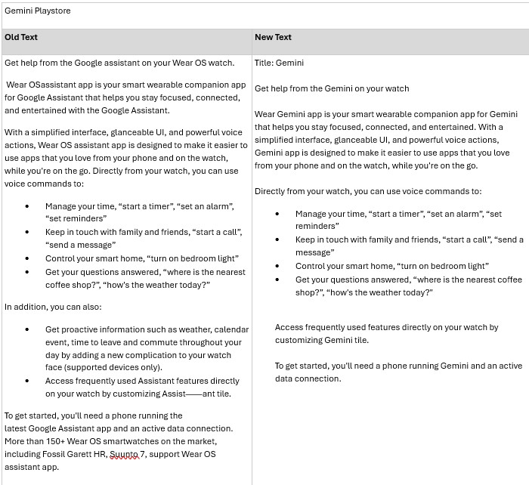
Google DeepMind Gemini 2.5
Google DeepMind
Google DeepMind was rapidly developing Gemini 2.5, a cutting-edge AI system designed to assist users across smartphones (Samsung), in-car systems (Auto), and wearable tech (Fitbit). As these platforms evolved, so did the need for clear, intelligent, and human-centered content to support interactions, guide users, and reinforce trust in the AI’s capabilities.
The Details
I was chosen to be the UX content designer with a deep understanding of conversational design and user experience best practices to write the user interface for the products. I worked with extensive teams in the fast-paced environment to create flows and dialog that matched business objective, increased under engagement, and followed best practices. Achievements:
Boosted user experience metrics through impactful, test-driven content.
Helped define Gemini’s tone across new devices and use cases.
Built scalable systems for consent, confirmation, and error messaging.
Influenced decision-making through strong content strategy and UX insights.

Slide 3
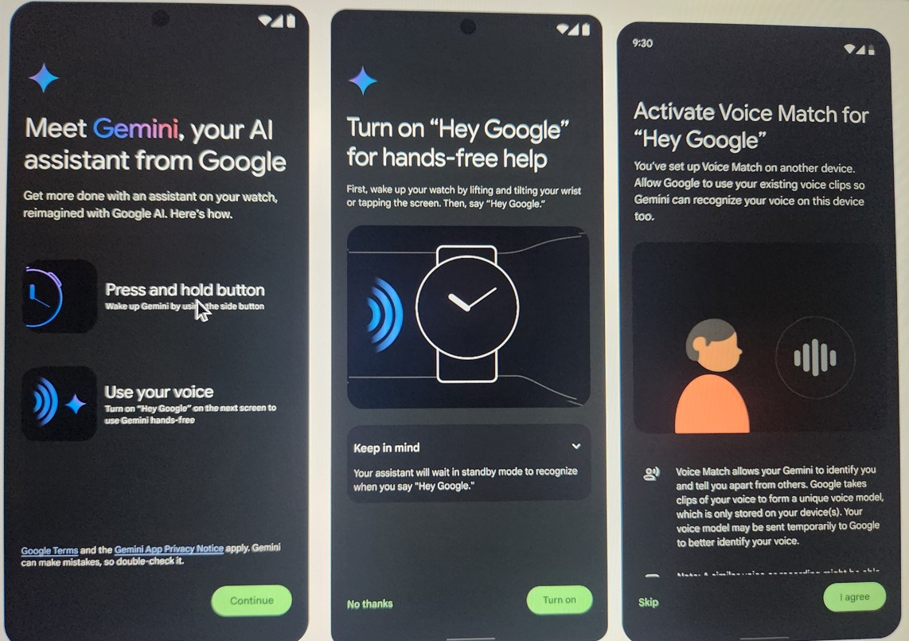
Google DeepMind Gemini 2.5
Project Details
Ada Burch
Conversation & Content Designer
Delivered end-to-end content for Gemini Extensions notices on Gemini Watch and Gemini Auto.
Wrote user-friendly and effective error strings for Gemini on Samsung S25, Apollo error messages, and GoWatch error punts.
Refined Gemini’s Processing Indicator Strings and Workspace Extension Confirmation flows, aligning microcopy with business goals while simplifying user understanding of complex AI actions.
The Approach
I partnered with product designers, researchers, engineers, and product managers to ensure the content aligned with the technical constraints and user needs. I also contributed to frameworks and string libraries that could scale across Gemini’s ecosystem, ensuring consistency and coherence across touchpoints.

Slide 4
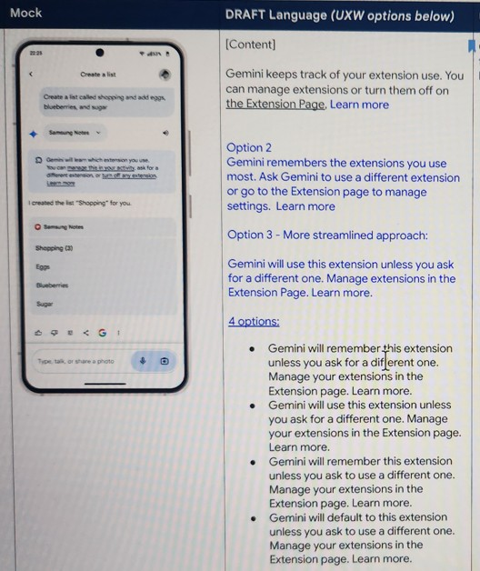
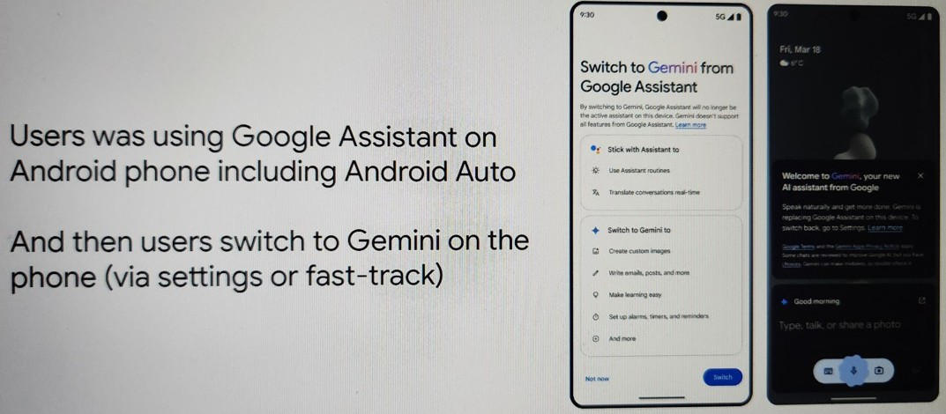
Google DeepMind Gemini 2.5
Project Details

